Slide 1


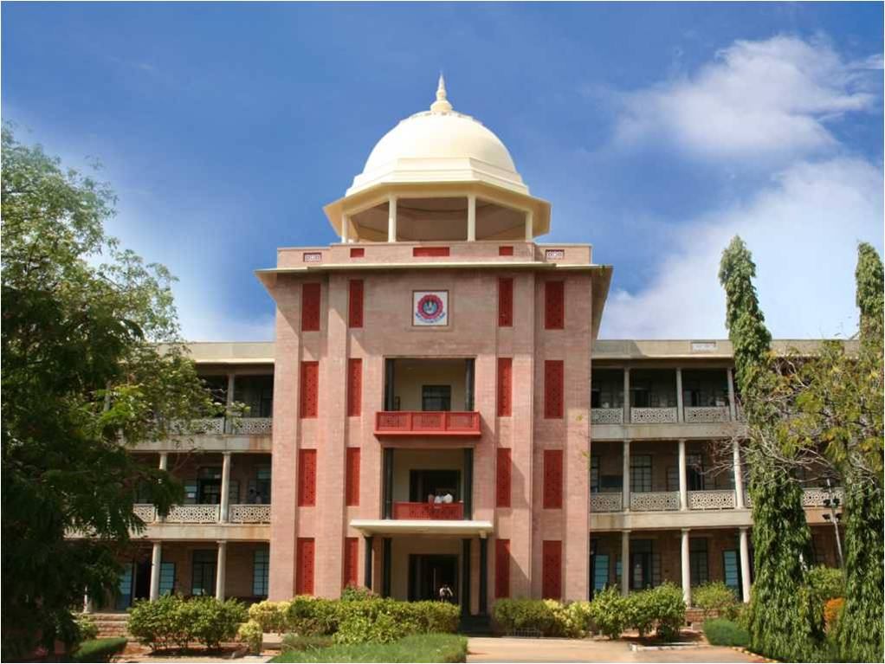
Organic Haircare Solutions
THIAGARAJAR COLLEGE OF ENGINEERING, MADURAI-15
(A Govt. Aided Autonomous Institution affiliated to Anna University)
- where quality and ethics matter
R. JASMINE – 917723Y010
K.M PRABHANJAN – 917723Y018
Type of the project: Social Relevance
*
Department of Computer Applications
1

Slide 2
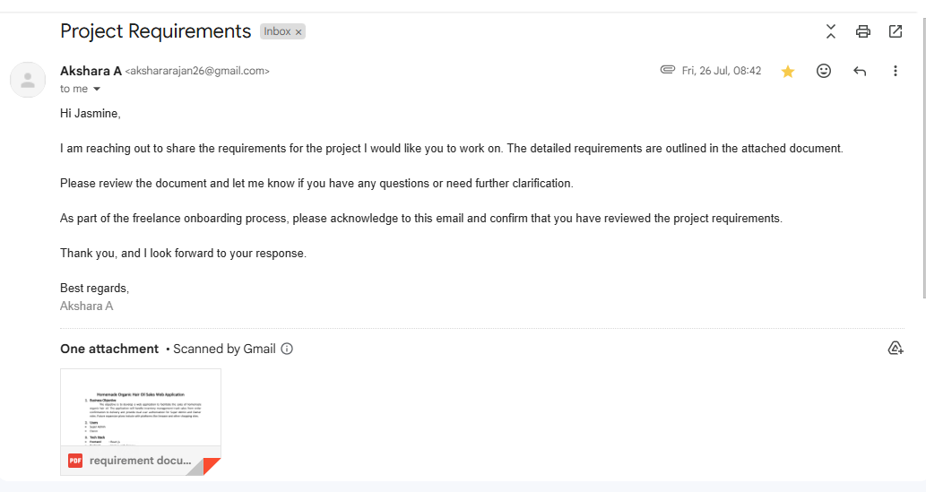
Title acknowledgement mail from Client
*
Department of Computer Applications
2

Slide 3
Problem Statement
Develop a web application to manage homemade organic hair oil business, with secure user roles and efficient inventory and sales tracking.
*
Department of Computer Applications
3

Slide 4
Requirements as specified by the Client
Implement a system that supports different user levels, ensuring that the right people have access to the right features.
Enable real-time monitoring and management of product inventory to ensure smooth operations.
*
Department of Computer Applications
4

Slide 5
Requirements as specified by the Client
Provide tools for tracking sales activities, from order processing to delivery, with insights to support decision-making.
Ensure a user-friendly interface that is accessible on multiple devices and facilitates efficient management.
*
Department of Computer Applications
5

Slide 6
Objectives
To create a web application that will enhance the management and growth of homemade organic hair oil business by integrating secure user access, efficient inventory tracking, and effective sales management. The platform will streamline operations, support scalability, and provide valuable insights to drive business success.
*
Department of Computer Applications
6

Slide 7
Tools and Technologies used
Software Technologies
Front End: React, Tailwind CSS, JavaScript
Server: Express JS
Backend: PostgreSQL
Testing: Jest Frame Work
Hardware Technologies
Operating System: Windows 8, 10, or above
Hard Disk: 40 GB
RAM: 4 GB or more
*
Department of Computer Applications
7

Slide 8
Benchmark applications
Module description | State-of-art solution available | Drawbacks of the solution | Features proposed to overcome
User Access and Purchase | Most e-commerce platforms require users to create an account and log in before making a purchase. | - Mandatory login can discourage potential buyers who prefer quick and anonymous purchases. - Increased friction in the checkout process, leading to higher cart abandonment rates. | -Allow guest checkout where users can purchase products without logging in. - Simplified and faster checkout process, improving user experience and reducing cart abandonment
*
Department of Computer Applications
8

Slide 9
Benchmark applications
Module description | State-of-art solution available | Drawbacks of the solution | Features proposed to overcome
Automated Email Notifications | Some logistics platforms provide email updates at specific milestones, but not all e-commerce platforms offer this. | - Limited email notifications are sent, and they may not cover all relevant milestones, leading to uncertainty for customers. - Manually triggered emails can cause delays and inconsistencies.. | -Allow guest checkout where users can purchase products without logging in. - Simplified and faster checkout process, improving user experience and reducing cart abandonment
*
Department of Computer Applications
9

Slide 10
Benchmark applications
Module description | State-of-art solution available | Drawbacks of the solution | Features proposed to overcome
Dashboard Customization for Admin and Super Admin | Most platforms provide a unified dashboard for all administrative roles with limited customization based on role-specific needs.. | Lack of differentiation in dashboard content can overwhelm users with irrelevant information. Admins may struggle to find the data and tools they need, leading to inefficiencies. | Implement role-specific dashboards where Admins and Super Admins see only the information and tools relevant to their responsibilities.
*
Department of Computer Applications
10

Slide 11
Module description
User Management:
Super Admin:
Full access to all functionalities and user roles
Oversee inventory, sales, and reporting features.
Owner
Limited access defined by the Super Admin
Confirm orders and update delivery status
*
Department of Computer Applications
11

Slide 12
Module description
Reporting and Analytics
Generate reports on sales performance and trends.
Provide reports on inventory levels and turnover
*
Department of Computer Applications
12

Slide 13
Module description
Sales Management
Confirm orders, generate invoices, and track deliveries
Order Management:
Users place orders; Super Admin and Owner manage and update all orders.
Track order status from confirmation to delivery.
*
Department of Computer Applications
13

Slide 14
Module description
Inventory Management:
Add, update, and remove products with details.
Monitor stock levels and alert for low inventory.
Generate inventory status and movement reports.
*
Department of Computer Applications
14

Slide 15
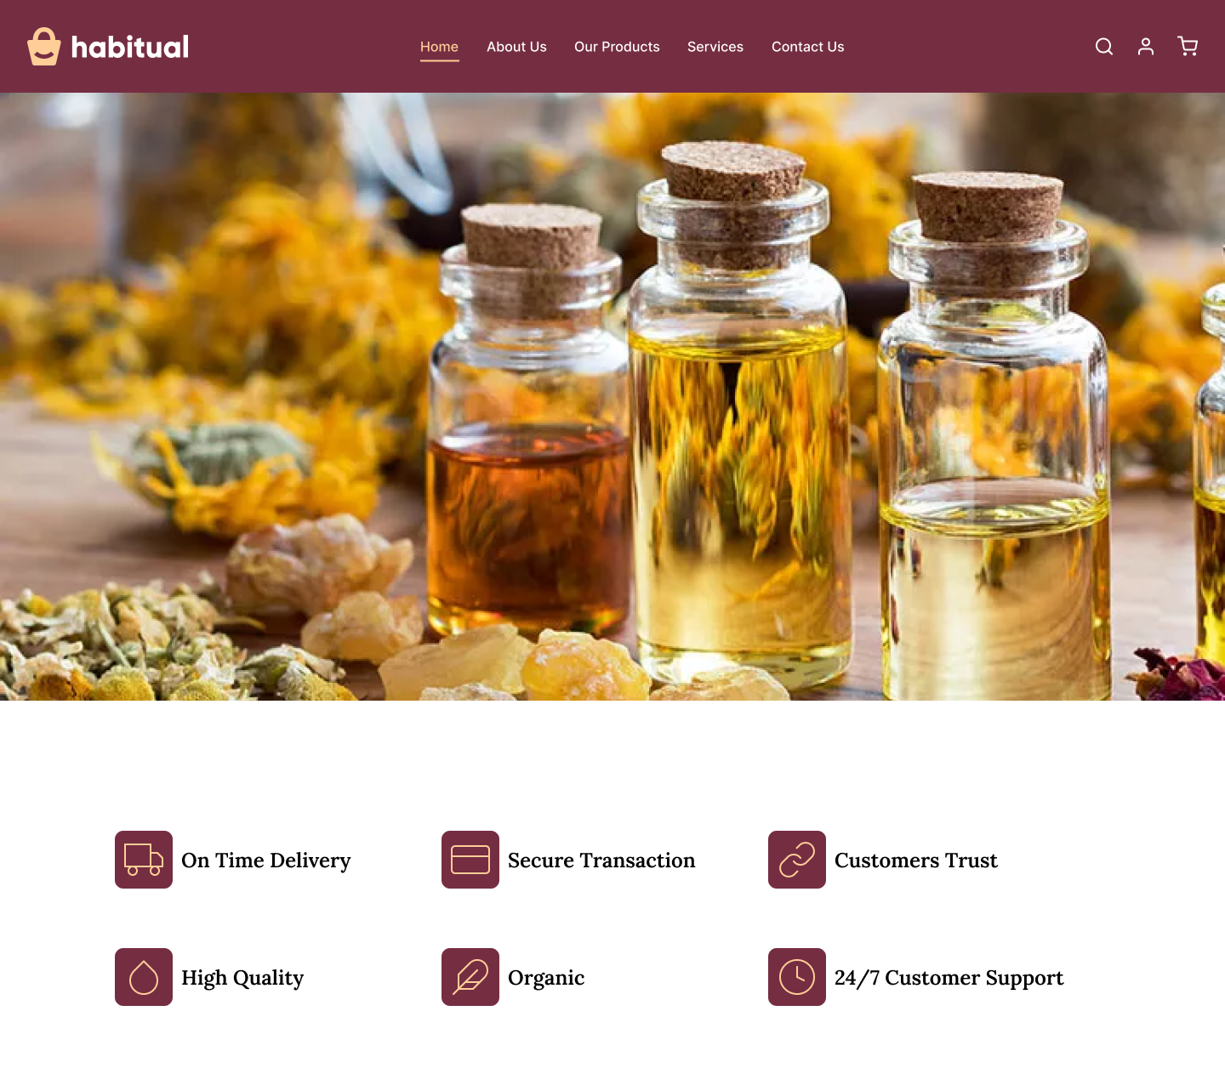
Design of our Application
*
Department of Computer Applications
15

Slide 16
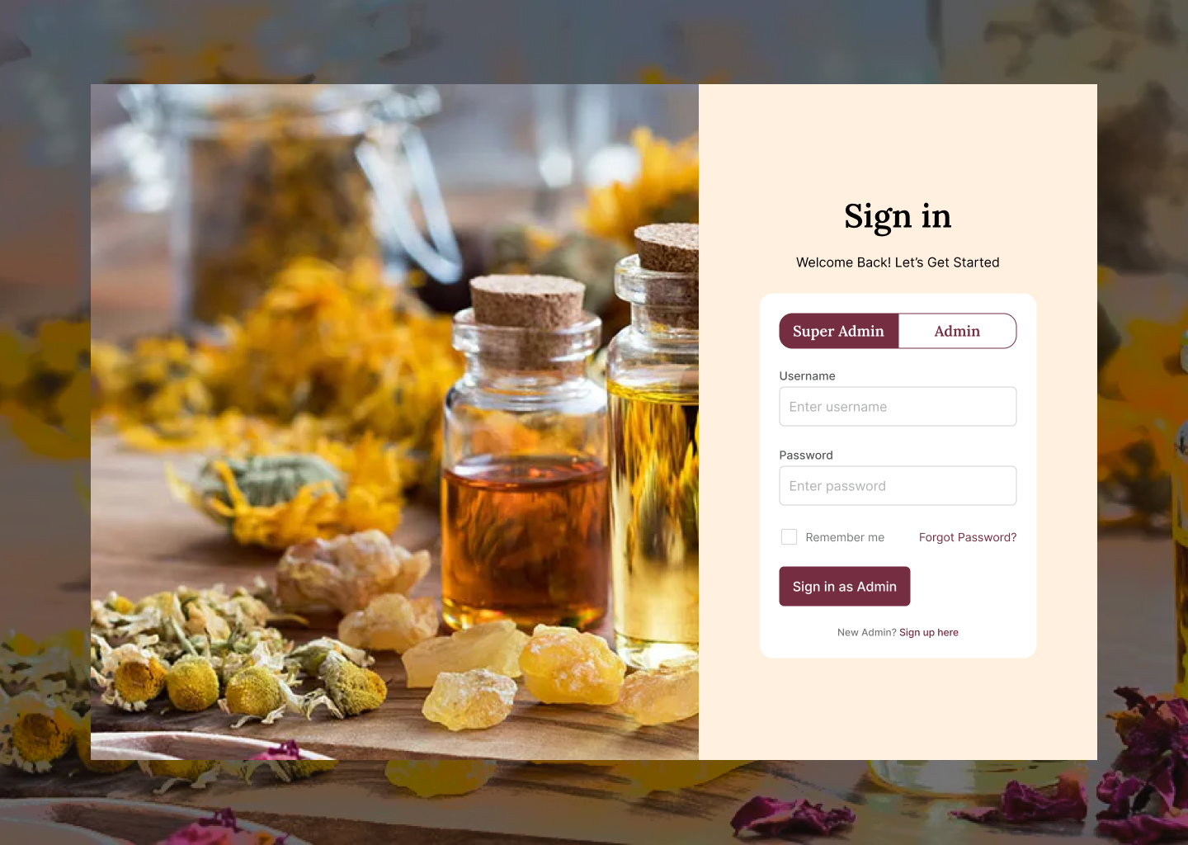
Design of our Application
*
Department of Computer Applications
16

Slide 17
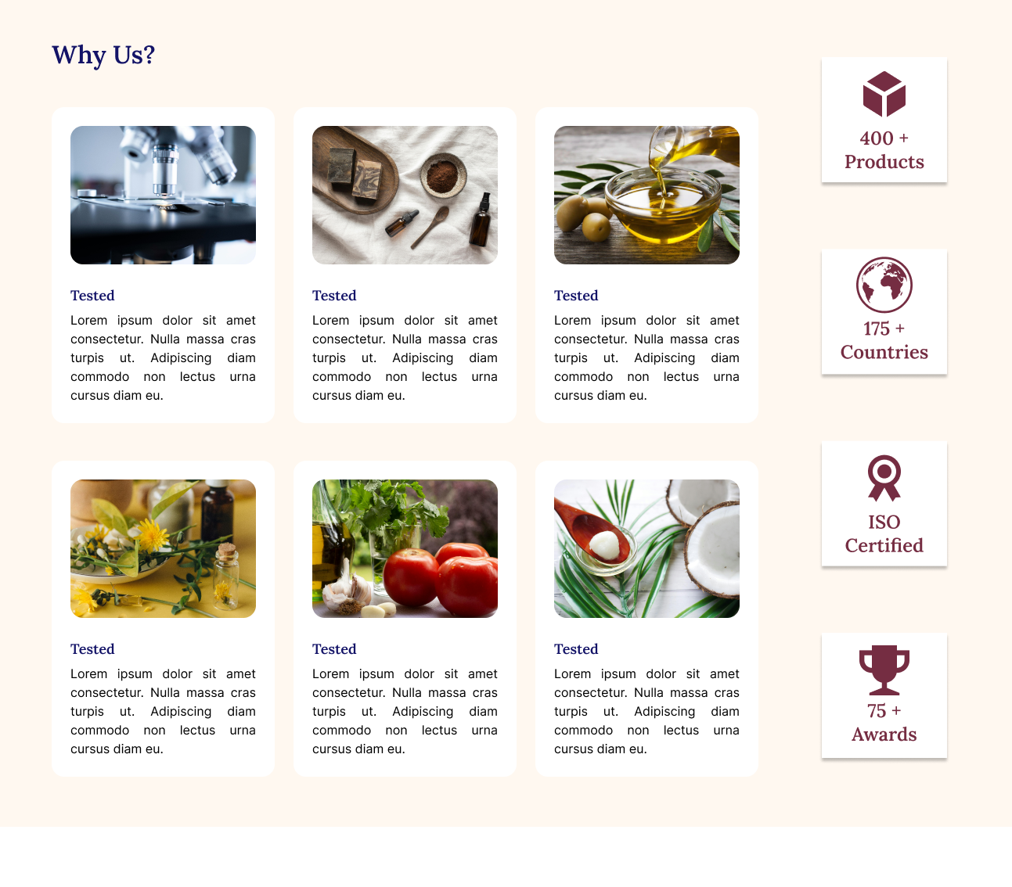
Design of our Application
*
Department of Computer Applications
17

Slide 18
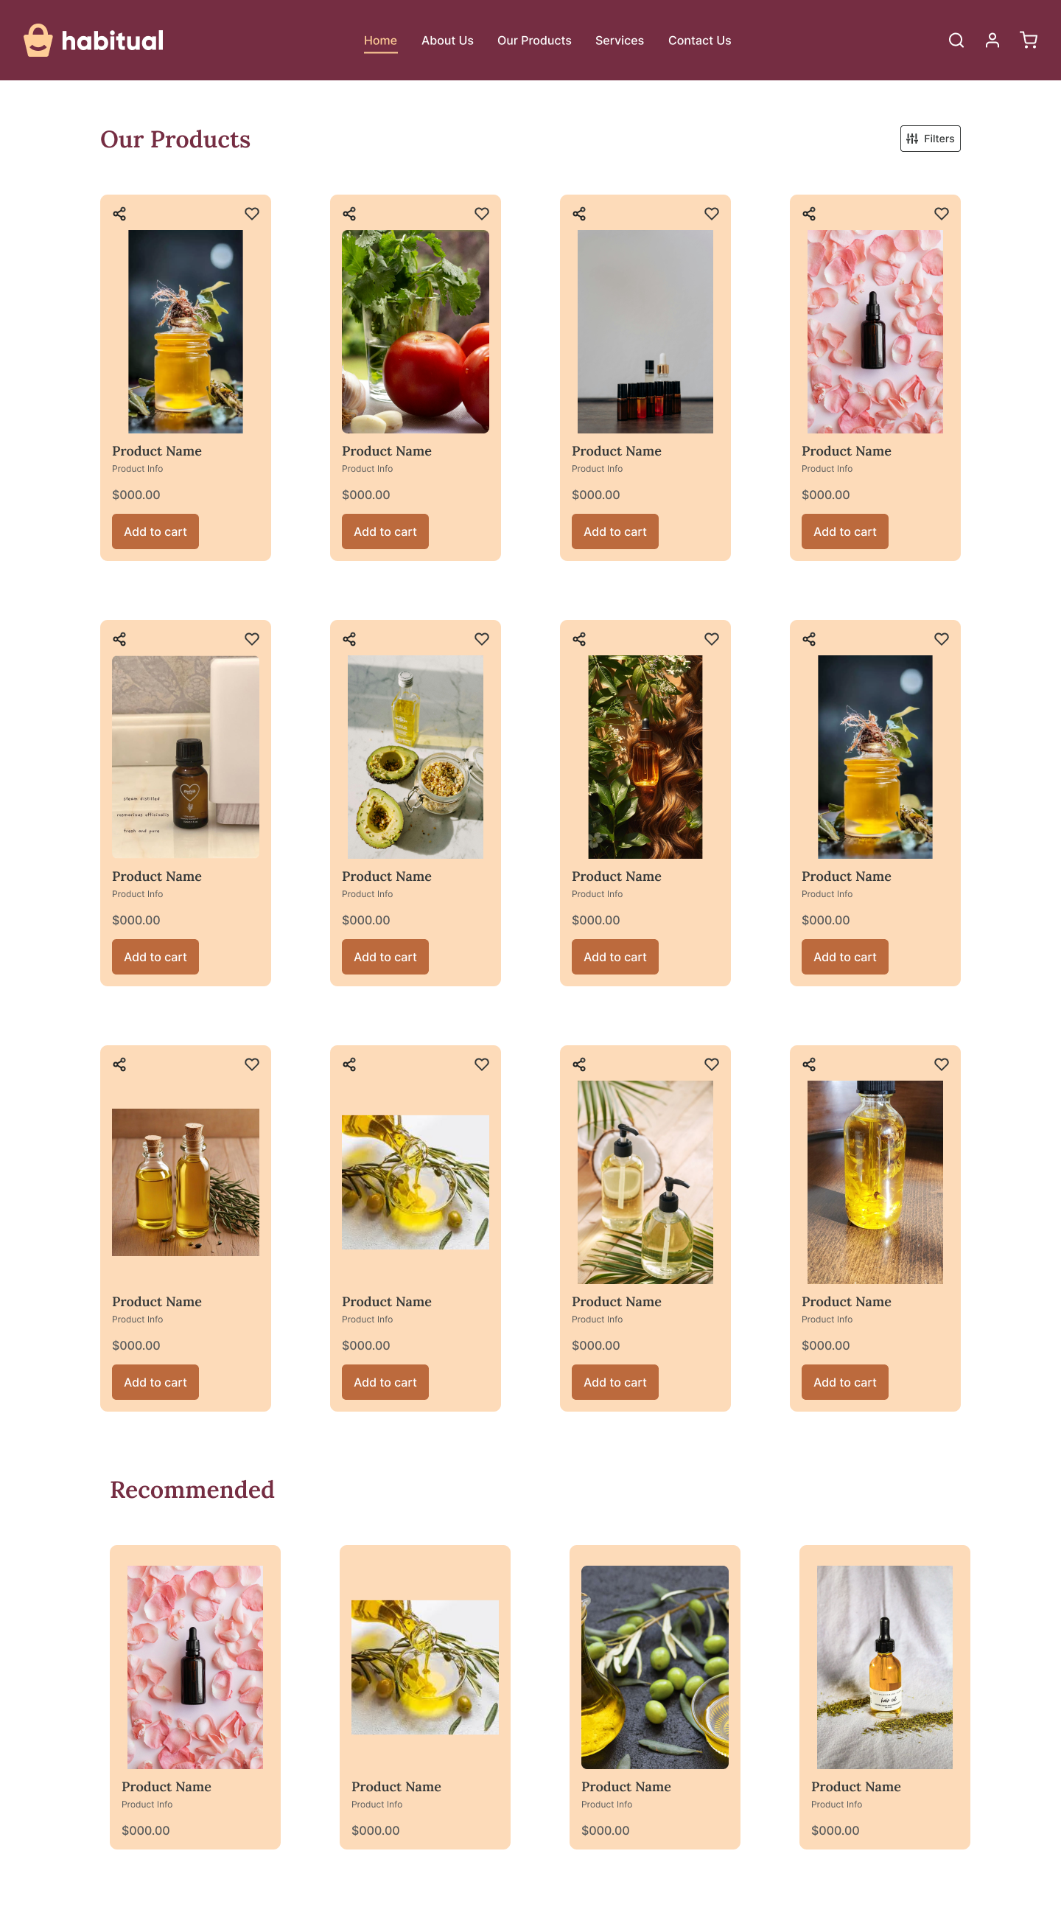
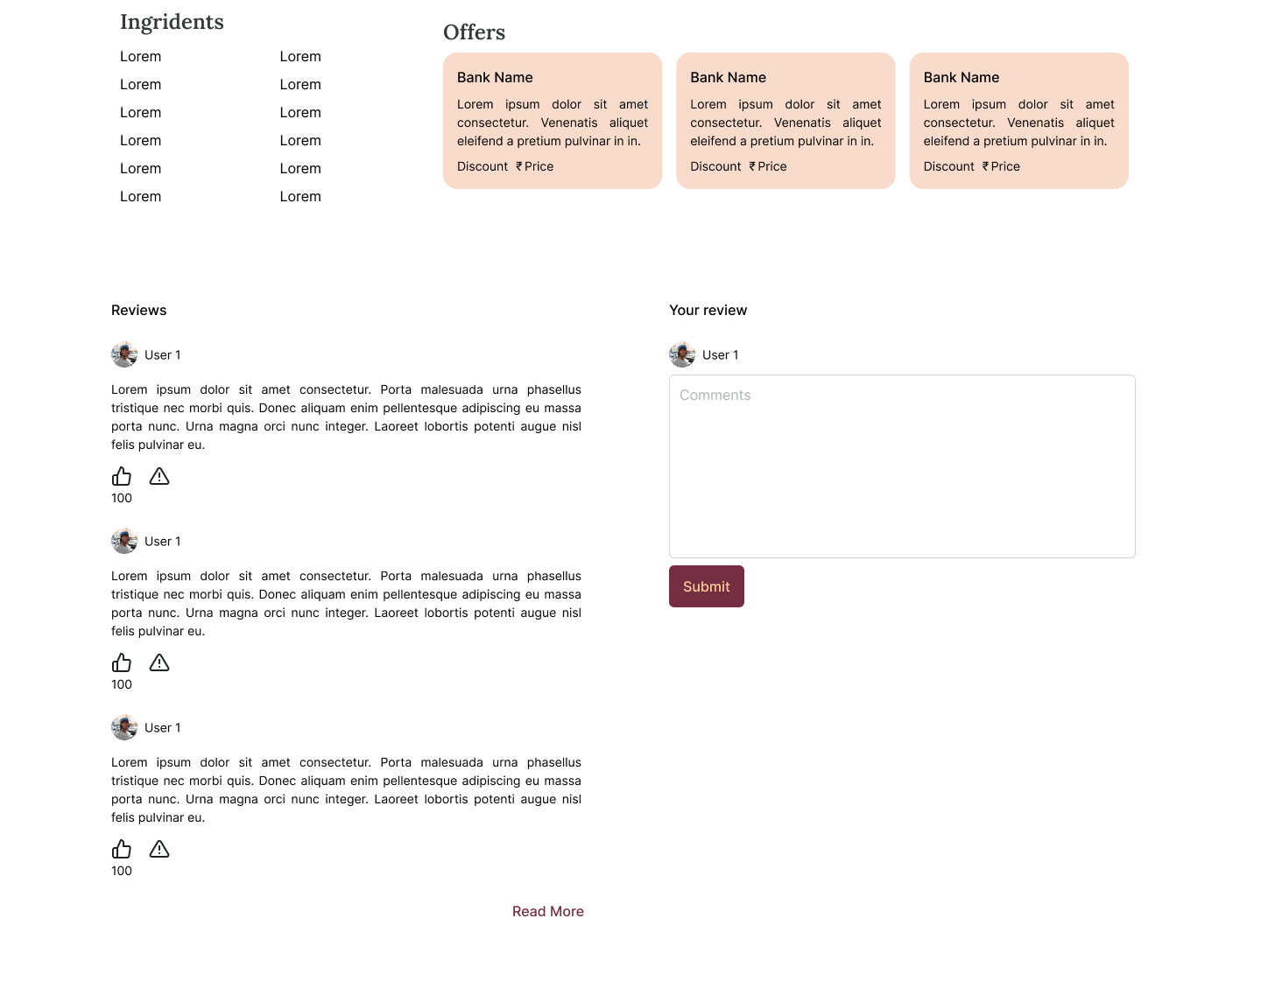
Design of our Application
*
Department of Computer Applications
18

Slide 19
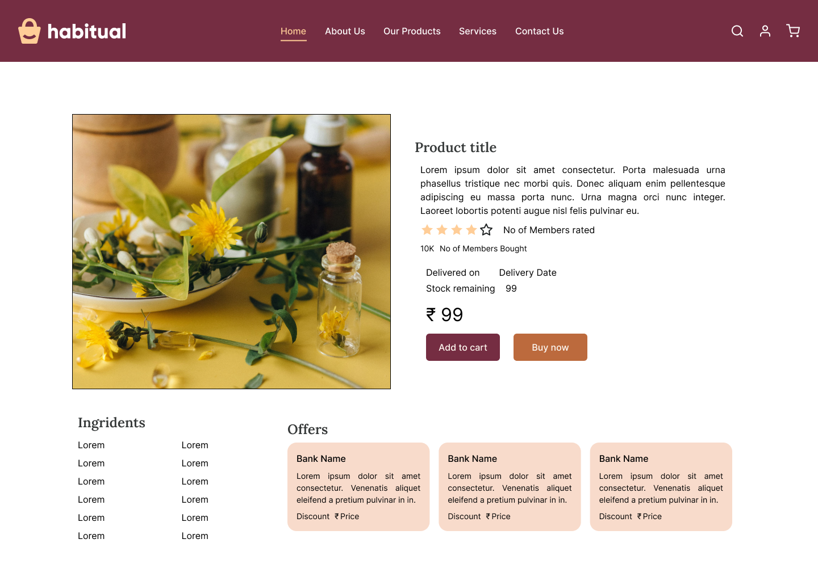
Design of our Application
*
Department of Computer Applications
19

Slide 20
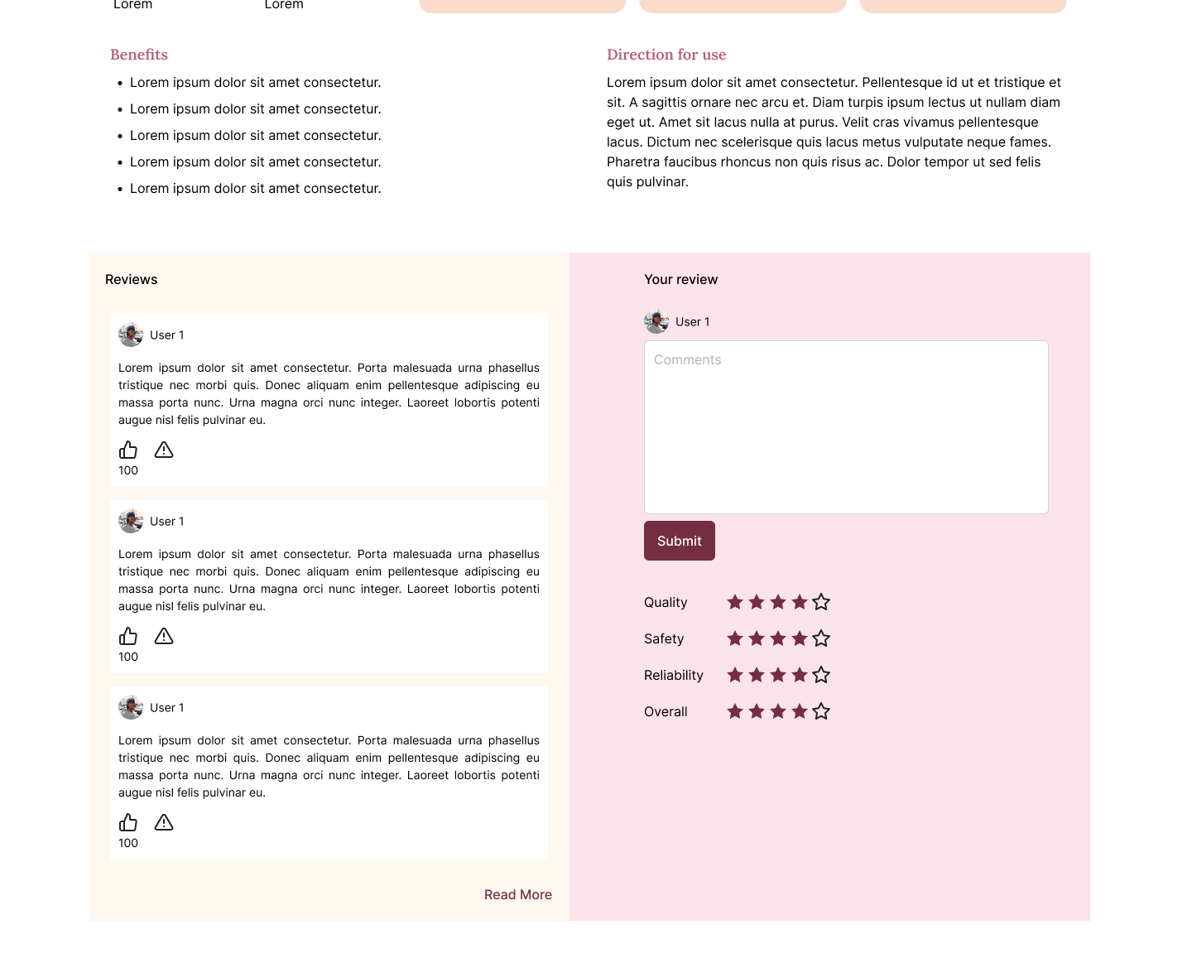
Design of our Application
*
Department of Computer Applications
20

Slide 21
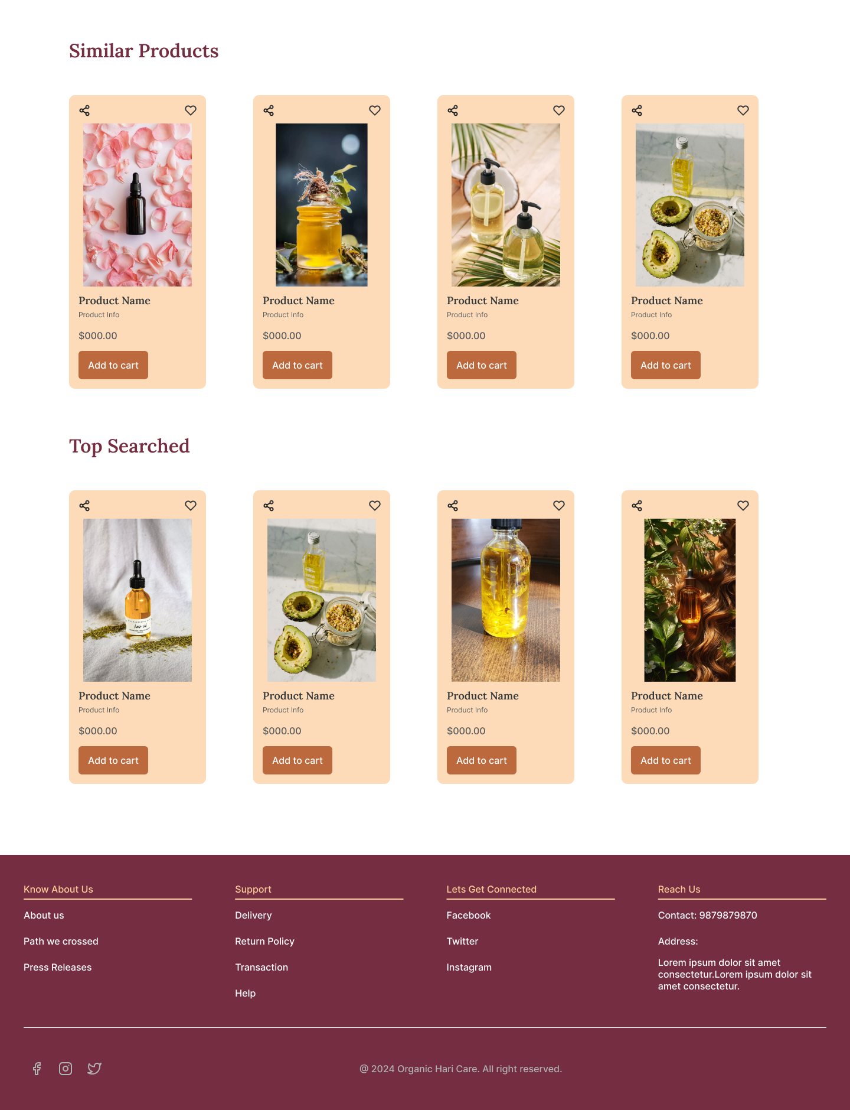
Design of our Application
*
Department of Computer Applications
21

Slide 22
Action Plan
Module No. | Module Name | Deadline
1 | User Management | 15/08/24
2 | Sales Management | 22/08/24
3 | Order Management | 31/08/24
4 | Inventory Management | 15/09/24
5 | Reporting and Analytics | 30/09/24
 | Project Document Report preparation | 01/10/24
 | Project Document Submission | 18/10/24
*
Department of Computer Applications
22

Slide 23
REFERENCES
BUY HAIR OIL
Buy Organic Oils Online in India | Pure & Sure – Phalada Pure & Sure (pureandsure.in)
ERVAMATIN HAIR OIL
ERVAMATINervamatin.com Ervamatin ANTI HAIR LOSS TREATMENT
*
Department of Computer Applications
23

